Slide 1

Software Dev. & Problem Solving 1
Z
CREATED BY:
Tamreen Ahamed
abasim Ibrahim
Ziad Tariq

Slide 2
Why do we need to clone a repository:
A
02
When you clone a repository using Git, you will obtain the complete repository, including all files, branches, This process is typically performed only once, at the beginning of your engagement with a project.
01
Having access to the entire repository offers the advantage of increased flexibility in your work. You are not limited in which files you can work on, enabling you to confidently make changes on a feature branch.

Slide 3
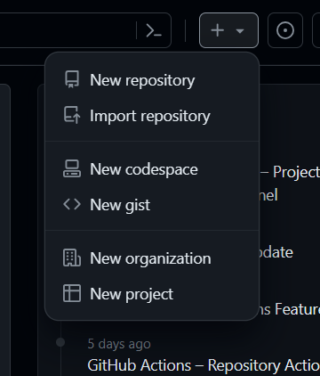
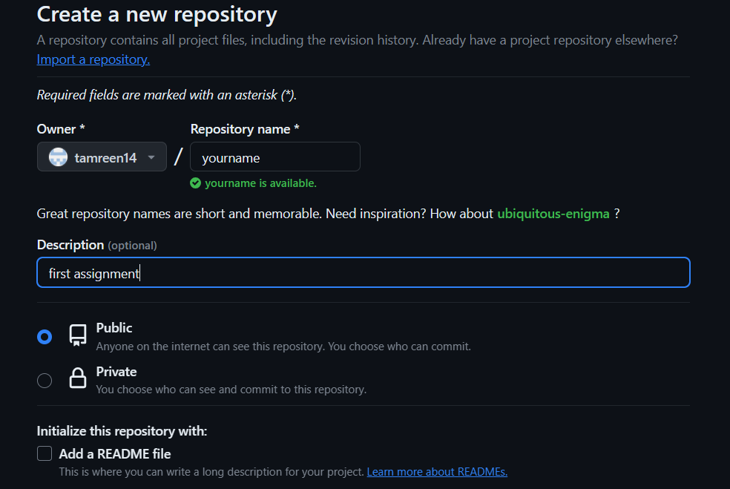
How to clone a repository:
T
First, you need to open the git hub website and press new repository
After you are done adding the name, of your file you must press “create repository” which you will find at the bottom of the website.

Slide 4
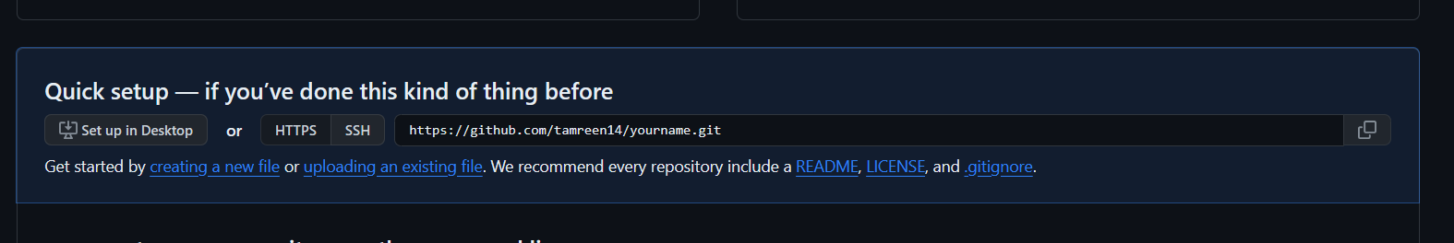
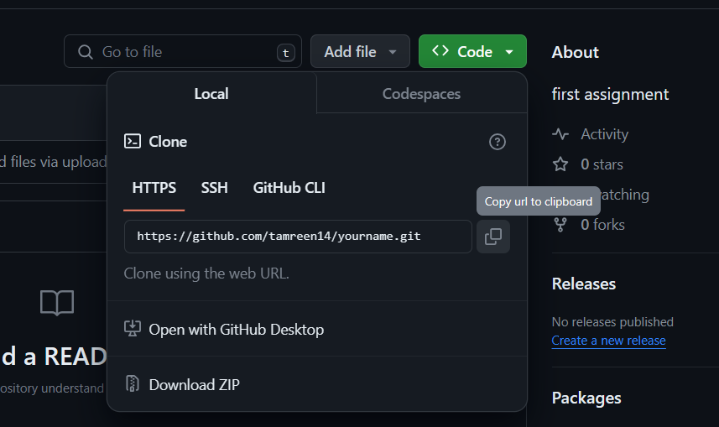
How to clone a repository:
T
Once you are done with the first and second step, you must upload a file by pressing “existing file link”
Once the changes are committed, you will have your new file ready in your repository. Now you need to download the repo in your system, so you press code, and then copy the url and paste it in the windows powershell

Slide 5
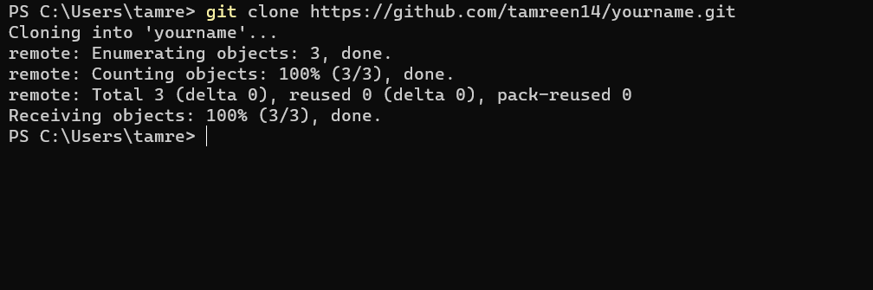

How to clone a repository:
T
Now you need to clone the repo, so you write the command “git clone” and paste the link,
then press enter.
And if you want to see that your folder exists,
write ls (means list) And your folder will show up in the list,
to go to your folder, you need to write cd “your folder’s name”
Cd stands for change directory

Slide 6
Git Pull: Without running git pull, your local repository will never be updated with changes from the remote. To recover and combine changes from the remote repository into the local repository, use git pull. Git pull is the result of combining two commands: git fetch and git merge. Git fetch command and git merge command are both different in operation. Git fetch fetches the changes while git merge merges them after fetching.
Z

Slide 7
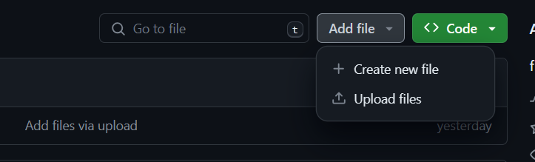
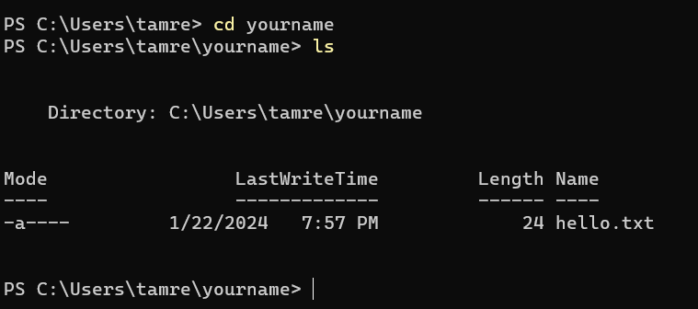
How to run git pull:
A
First you need to create a new file from git hub.
Now to see the new changes you have made, write the command “cd (your folder name)” then write the command “ls” to see the new file you have added,
However, your new file will not show up except the previous old files.

Slide 8
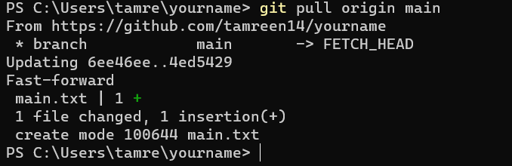
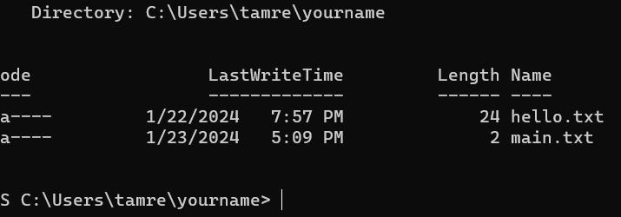
How to run git pull:
Z
Now you must write the command “git pull origin main” to add the recent file which you have created.
Now if you write the command “ls” your new file will appear.

Slide 9
Merge conflict: Conflicts occur when two people change the same lines in a file or when one developer deletes a file while another developer is modifying it. Git cannot automatically determine the correct version in these cases. Only the developer conducting the merge is affected by conflicts, and the rest of the team is unaware of them. Git will label the file as conflicted and stop the merging process. It is then the responsibility of the developers to resolve the conflict.
A

